Slide 1
Calculating NDVI Using Parallel Processing
By: Shubhrose Singh

Slide 2
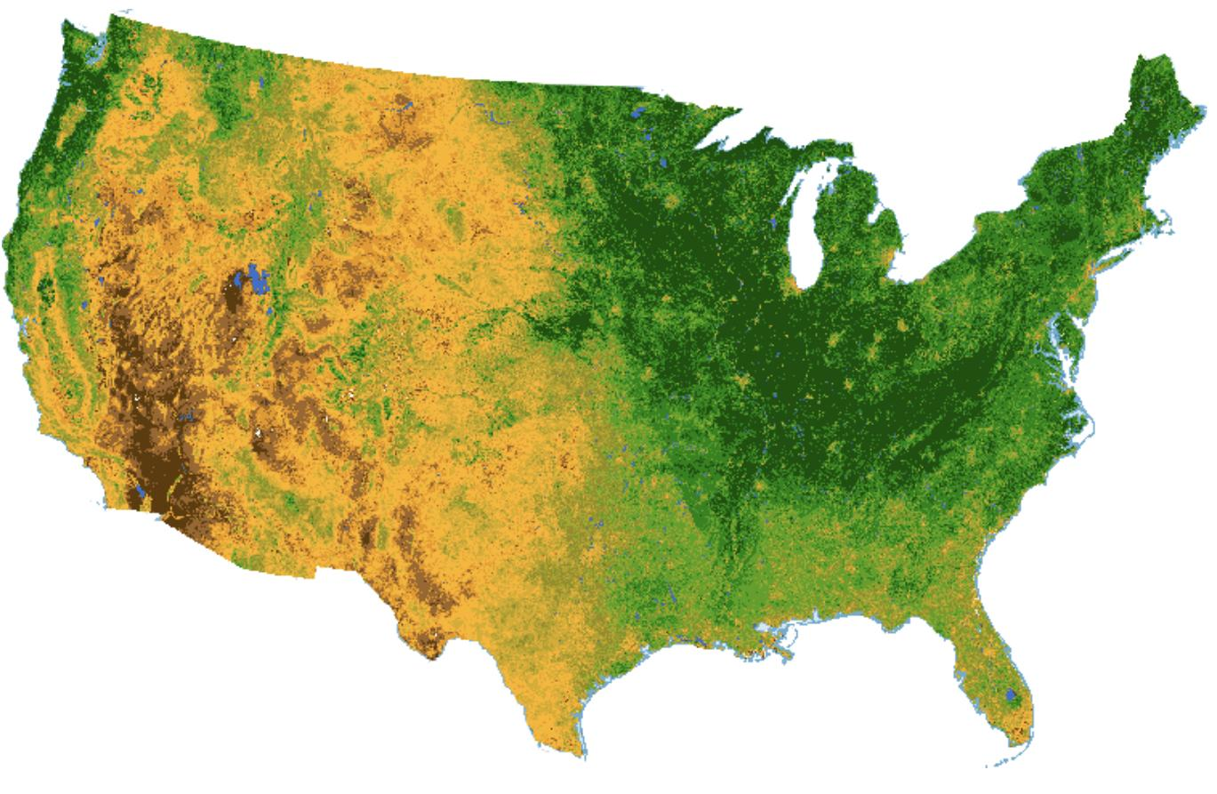
What is NDVI?
NDVI: Normalized Difference Vegetation Index
Ranges from -1 to +1
Negative values: Highly likely that its water
Close to +1, high possibility that it’s dense green leaves
Close to zero, likely no green leaves and it could be urbanized area.

Slide 3
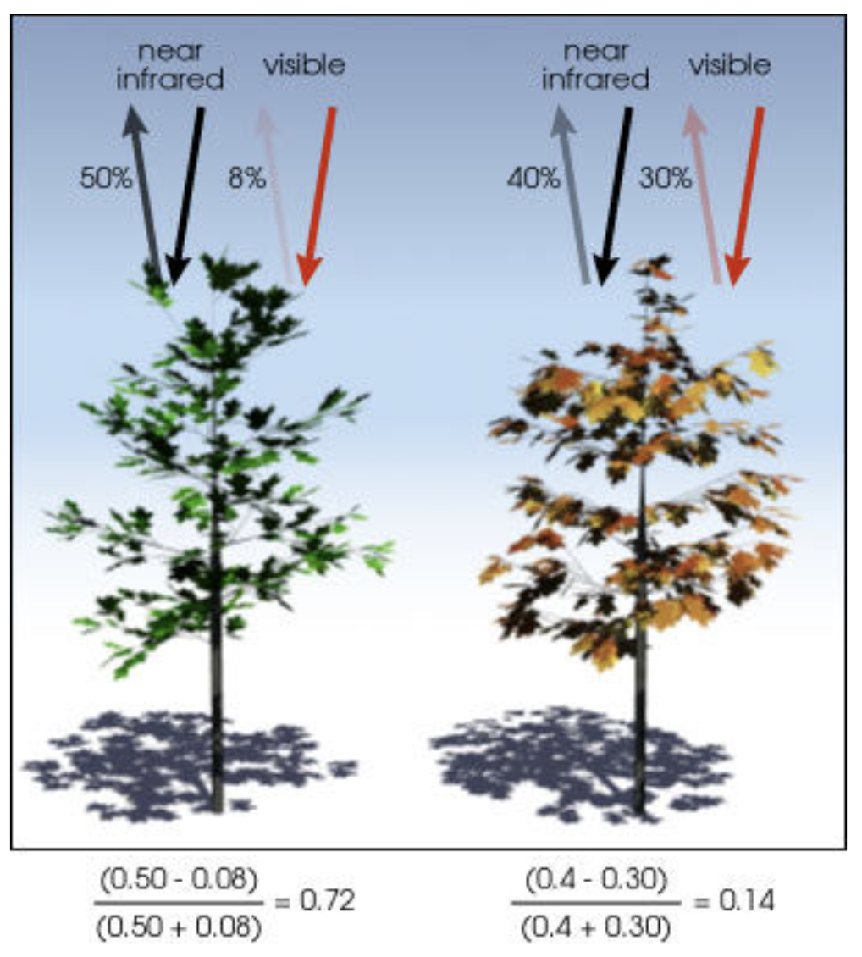
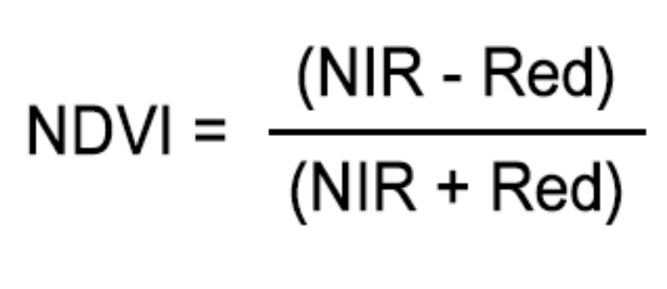
How do you calculate NDVI?
NDVI uses the NIR and red channels in its formula
Idea: Healthy vegetation (chlorophyll) reflects more near-infrared (NIR) and green light compared to other wavelengths but it absorbs more red and blue light.
Satellite sensors like Landsat and Sentinel-2 both have the necessary bands with NIR and red.
Overall: When you have high NDVI values, you have healthier vegetation

Slide 4
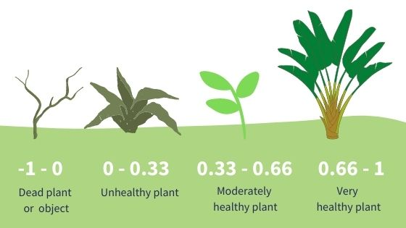
How Do We Use NDVI?
Farmers use NDVI for precision farming and to measure biomass
Precision farming: the science of improving crop yields and assisting management decisions using high technology sensor and analysis tools.
Foresters use NDVI to quantify forest supply and leaf area index.
NASA states that NDVI is a good indicator of drought.
When water limits vegetation growth, it has a lower relative NDVI and density of vegetation.

Slide 5
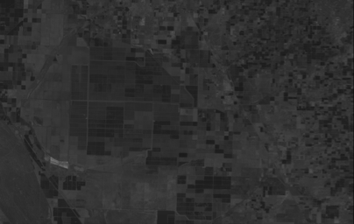
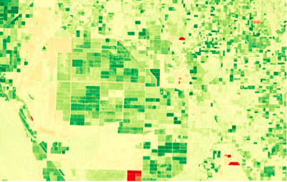
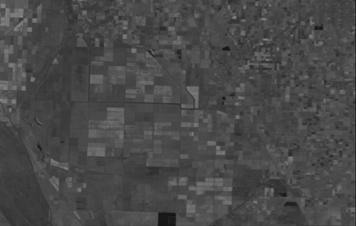
Serial Processing
Processor ID: 0
RED
NDVI
NIR

Slide 6
Parallel Processing Part 1
Processor ID: 0
RED 1
RED
RED 1
RED 2
NIR 1
NIR 1
Processor ID: 1
NIR
RED 2
NIR 2
NIR 2

Slide 7
Parallel Processing Part 2
Processor ID: 0
NDVI
RED 1
NDVI 1
NIR 1
Processor ID: 1
RED 2
NDVI 2
NIR 2

Slide 8
